Slide 1



Laser Device – EMM5
Process description
Jeroen Koldenhof (Javra) / Peter Bastiaansen (EMS)

Slide 2
Measurement Process on one slitted coil
Measure width manually Begin-meting
Get Measurements Eind-meting WS
Get Measurements Begin-meting DS
Get Measurements Eind-meting DS
Get Measurements Begin-meting WS
With laser
4 times same process will be handled.

Slide 3
Get Measurement Begin-meting WS
Manually width enter manually in EMM5
Laser Get batch measurements
EMM5 Get Measurements
Laser Get Thickness
STEP 1) Activity Operator:
Measure width manually and enter manually in EMM5
STEP 2) Activity Operator (Laser):
Start get thickness (laser software)
Stop/accept get thickness (laser software). (Inside laser navigator screen which field is thackness because getmeasurement() method fetch the data from the navigator screen field.)
Start get batch info (laser software)
Stop/accept get batch info:
Output 1,
Output 2,
Output 3,
Output 4,
STEP 3) automatically EMM5:
Get measurements Begin-meting WS:
Thickness
Batch information for
Burr
Camber
Waveheight
Wave-factor* ( Wave-factor is the thing which balance the risk and aware the coming error so that wave-facetor is not measuring thnig it just a calculation )
* Wave factor must be placed in a/acotbmeas.p - in stead of WaveLen
STEP 4) Validation EMM5 values:
Test Values are oke
Same as it is now
Test Values are not oke
Same as it is now

Slide 4
Get Measurement EMM5
Laser Get Thickness
EMM5 Get Measurement
EMM5 Get Measurements
Laser Get batch measurements
Following buttons needed in EMM5:
Get Measurement thickness Begin-meting WS
Get Measurement Begin-meting WS
Get Measurement thickness Begin-meting DS
Get Measurement Begin-meting DS
Get Measurement thickness Eind-meting WS
Get Measurement Eind-meting WS
Get Measurement thickness Eind-meting DS
Get Measurement Eind-meting DS
Following data will be measured in EMM, after pushing each button:
Thickness (get measurement)
Batch info (get batch measurement)

Slide 5
Get Measurement detailed EMM5
Laser Get Thickness
Laser Get batch measurements
EMM5 Get Measurements
Step 1: Thickness will be measured as one measurement. EMM5 will get this by ‘get measurement’ and put this in the right field in EMM5 (thickness WS/DS/Begin/Eind)
Step 2: The batchfile is get by EMM5, as per the example delivered during test on 17 November. The following information is stored in this batch:
Output 1: Height of material not relevant for storage
Output 2: Waviness
Output 3: Burr
Output 4: Camber
Where is the wave-length, needed to calculate wave-factor? ( for this we should maintain another field in the laser navigator so that we can get this value from batch file or is there any way to get value of wave-length because we cannot sketch the wavelenth graph of all records each time.)

Slide 6
Data to store in EMM5
Laser Get Thickness
Laser Get batch measurements
EMM5 Get Measurements
Step 1: Thickness will be kept 1 on 1
Step 2:
Output 1: Height of material not relevant for storage
Output 2: Waviness,
height must be < 3 mm
Factor must be below 1,5% [wave height in mm / wave length in mm) * 100%]
Output 3: Burr,
90-% > max 0,010 mm ( Okay we can do that while doing valiedation of the data)
10% -> max 0,020 mm ( Okay we can do that while doing valiedation of the data)
Output 4: Camber
Width < 250 mm -> must be < 0,5 mm
Width > 250 mm -> must be < 0,2 mm

Slide 7
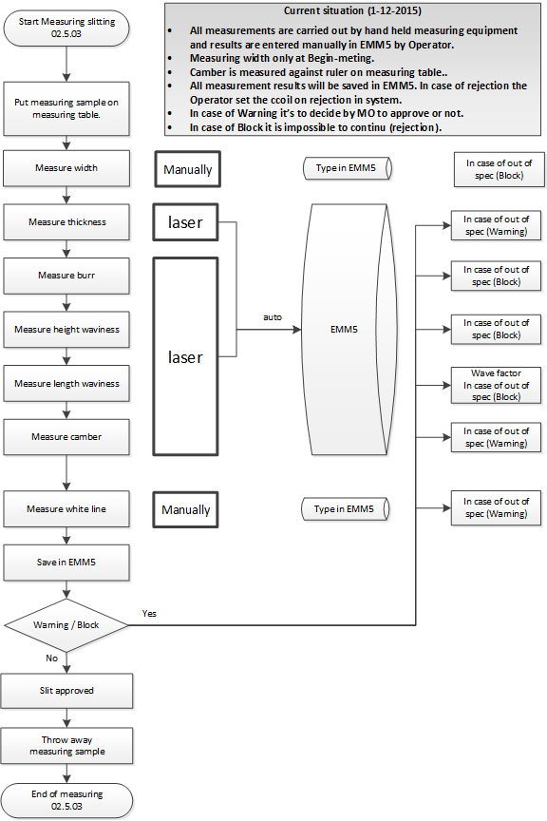
Flow
chart

Slide 8
Open Questions
Operator is doing the test with the Laser and is starting the measurement in EMM5; What is he doing with the outcome of the test result values…. Please save test results in seperate file if possible.
Which values need to be saved in EMM5, I got from the laser:
Thickness (once) save
Height (batch) -> highest number? Yes and save
Waviness (batch) -> highest number? Yes and save
Burr (batch) -> highest number? Yes and save
Camber (batch) -> highest number? Yes and save
Do we need to get the WAVELENGTH also? If so, please let me know how I can get this information out of the batch file
Do we need to store the WAVEFACTOR also? Yes, see slide 3 → step 3
Based on the Camber formule I need also the width of the sample. How do I get this? Will the operator fill this manually? In EMM5? Width is not needed for any calculation.
In one of the earlier mails I see something about thickness variation? Is this the variation between WS, DS, Start and End, or? Forget discussion regarding thickness variation, this is something EMS internal (based on results in measured thickness which are saved in EMM5).

